Slide 1





FUZZY BASED DIETARY CLINICAL DECISION SUPPORT SYSTEM FOR PATIENTS WITH MULTIPLE CHRONIC CONDITIONS (MCCS)
BMD302-Clinical Informatics

Slide 2
DR. SAHAR FAWZI
ENG. MALAK SOLIMAN
Mariam salama 211001825
Rana Ibrahim 211001782
Shrouk Khaled 211001923
Salma AbdelAzim 211001665
Doha Abdallahkhalil 211001874

Slide 3


01- INTRODUCTION
The study discusses the complexity of setting diets for patients with multiple chronic conditions (MCCs), highlighting the need for a decision support system that integrates clinical evidence with best practices.

Slide 4


The difficulty in determining daily micronutrient and macronutrient intake due to factors like age, gender, physical condition, and disease presence. It calls for a decision support system that integrates clinical evidence with practice for severe conditions with multiple chronic diseases.

Slide 5
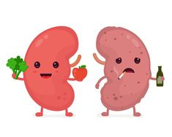

STUDY AIM
The study aims to model a knowledge-based clinical decision support system using Mamdani's fuzzy inference system to provide optimal dietary recommendations for patients with multiple chronic diseases.

Slide 6
METHODOLGY
Inclusion and exclusion criteria.
Knowledge base system development.
Architecture of the fuzzy model.
System evaluation.

Slide 7
METHODOLGY
Inclusion and exclusion criteria.
a clinical decision support system (CDSS) based on the fuzzy inference system was modeled to help dietitians to set an optimal diet for MCCs patients

Slide 8
METHODOLGY
Knowledge base system development.
Knowledge base system development.
- the first step, a review of the literature
- second step, a questionnaire was developed based on the results
obtained fromthe literature addition to expert opinions,

Slide 9
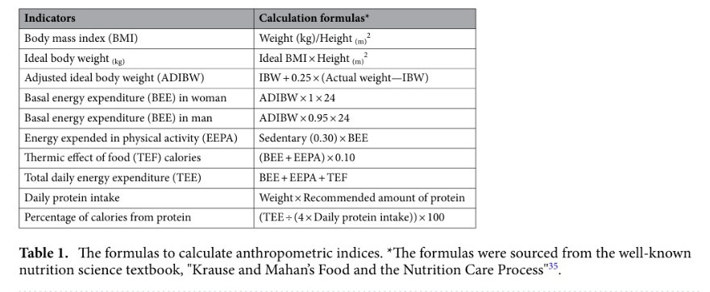
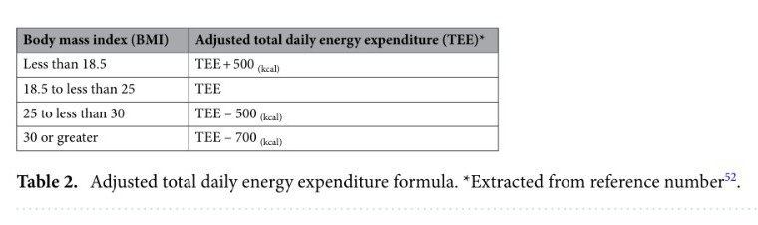
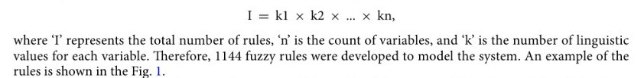
Methodolgy

Slide 10
METHODOLGY
Architecture of the fuzzy model.
the Mamdani inference method was employed as the inference engine and used for the defuzzification stage.
the Gaussian Membership Function was employed to determine the member ship values of input and output variables.

Slide 11
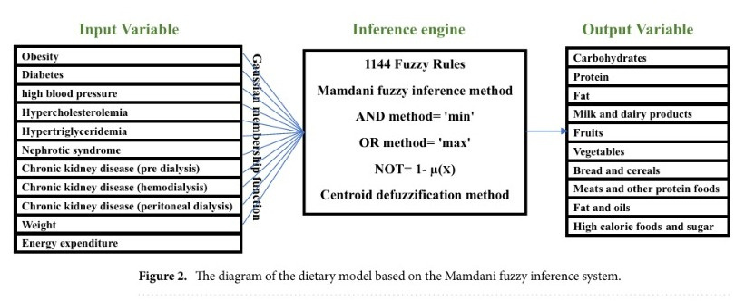
METHODOLGY
Architecture of the fuzzy model.

Slide 12
METHODOLGY
System evaluation.
A web-based platform was designed to implement and test the model. Therefore, the information related to 100 nutritional records was entered into this platform.

Slide 13
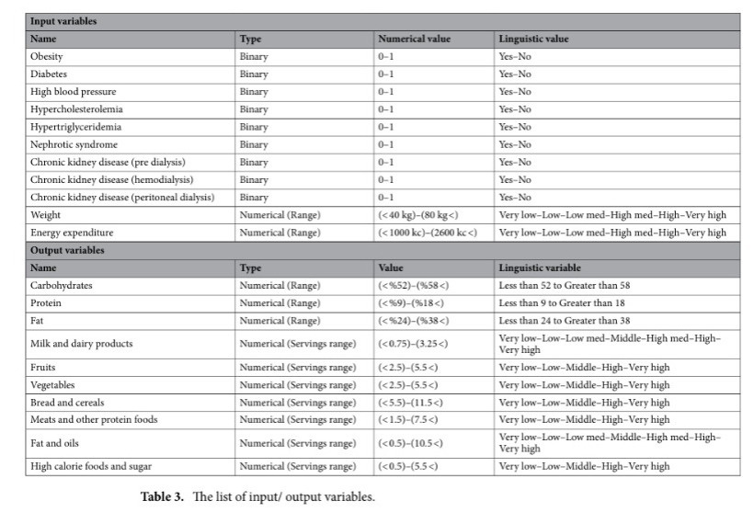
METHODOLGY
System evaluation.

Slide 14
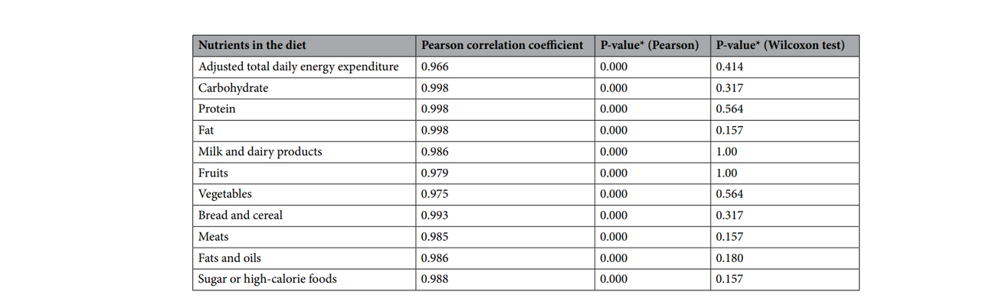

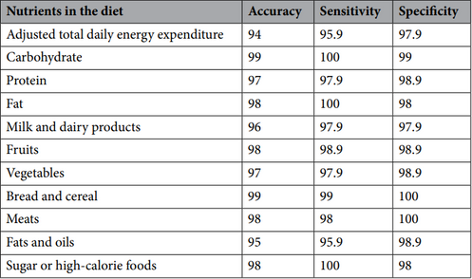
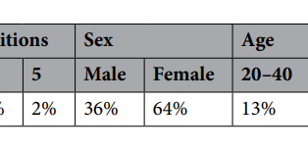
RESULTS
The study evaluated the performance of the fuzzy logic model in comparison to the diet set by nutritionists for patients with multiple chronic conditions.
Participant Characteristics
Comparison of Diets
Correlation Analysis
Model Performance

Slide 15
RESULTS
These findings suggest that the fuzzy logic model performed well in adjusting the diet for patients with MCCs, showing strong agreement with the diet set by nutritionists and high accuracy in recommending nutrient intake 5.
The results indicate that the fuzzy logic model has the potential to be a valuable tool for dietitians in adjusting the diet for patients with multiple chronic conditions, providing a reliable and accurate decision support system

Slide 16
DISCUSSION
The study aims to develop a high-accuracy Decision Support System (DSS) to aid nutritionists in designing diets for patients with Multiple Chronic Conditions (MCCs).
Unlike studies focused on self-care, this study proposes a model to assist dietitians in adjusting diets for patients with MCCs.

Slide 17


OTHER ALGORITHMS
decision tree hierarchical models
DIETOS
Jena

Slide 18
Limitations
Finding similar studies that support the results as most studies in dietary recommendations focused on patients with a single disease or healthy individuals rather than MCCs

Slide 19
Conclusion
The study indicates that using the fuzzy logic algorithm is effective for creating Clinical Decision Support Systems (CDSSs) for dietary recommendations.
The proposed system showed improvements in the reliability, speed, and accuracy of dietitians' decision-making for setting optimal diets for patients with Multiple Chronic Conditions (MCCs).

Slide 20
Conclusion
There is potential to extend the system by including rules for micronutrient and fluid intake, making it more comprehensive.
With the addition of rules for other MCCs and the development of its knowledge base, the system could become valuable in clinical decision-making, providing suitable diets for a variety of patients with different chronic conditions.

Slide 21

REFRENCES
https://pubmed.ncbi.nlm.nih.gov/37500949/

Slide 22


